Slide 1
sdmay19-17:
Burns and McDonnell Substation Design
Tom Kelly, Connor Mislivec, Jake Heiller, Rebecca Franzen,
Wilson Pietruszewski, Riley O’Donnell, Nicolaus Cory

Slide 2
Client Overview
Engineer-architect-contractor consulting firm
Headquartered in Kansas City, Missouri

Slide 3
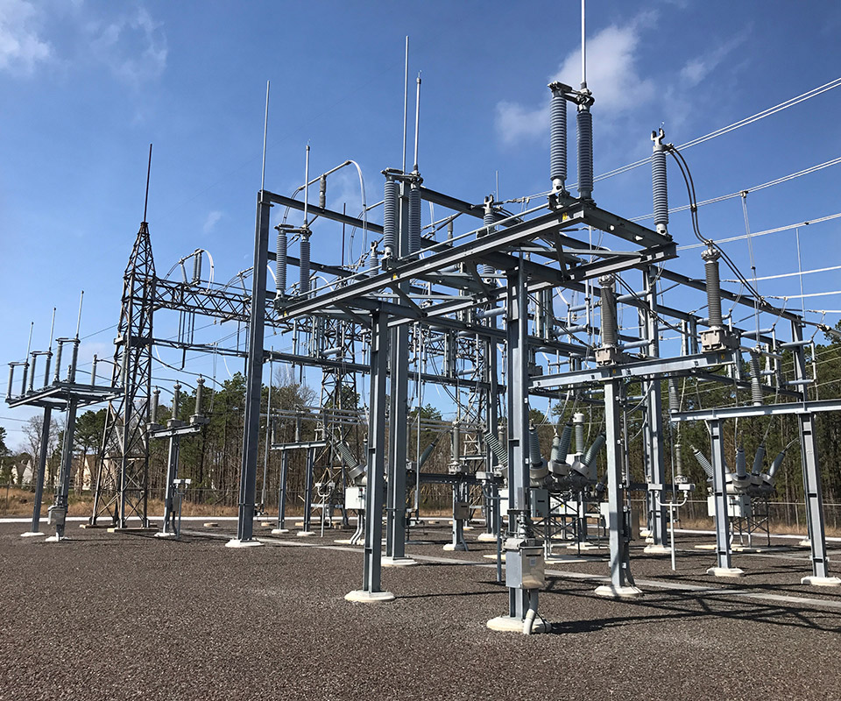
Problem Statement
General problem
High voltage distribution is unsafe
Unable to transmit power long distances
Our solution
Design 138/69 kV greenfield substation
Regulate voltage levels in/out
Ring bus configuration
http://gannettfleming.com/Projects/2015/10/19/11/29/mill-electrical-substation-upgrade

Slide 4
Functional Requirements
Site Design & Substation Layout
Ground Grid & Lightning Protection
125VDC Station Battery Design
AC Study
Relaying & Controls
One-line
Breaker Schematics
Transformer Schematics
Line Differential Schematics

Slide 5
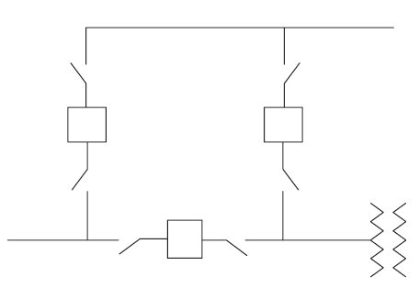
Technical/Other Constraints/Considerations
Three 138 kV Circuit Breakers
One 69 kV Circuit Breaker
One 138/69 kV Transformer
Ring Bus Configuration
Future “Breaker-and-a-half” Scheme
Two transmission lines entering/exiting substation
Grounding System withstand 21 kA Fault Current
Site Size of 400’ x 400’
http://eblogbd.com/detils-air-insulated-substations-bus-switching-configurations/

Slide 6
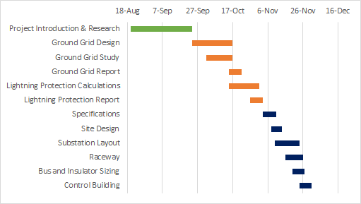
Semester 1
3 deliverables
Grounding design- November 2
Lightning Protection Design- November 2
Physical Design- November 30

Slide 7
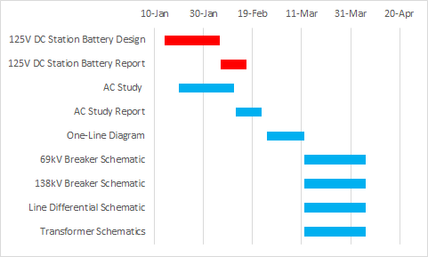
Semester 2
2 deliverables
AC/DC Studies- March 1
Controls and NIA- April 12

Slide 8
QC Process (Testing)
Q1 Review: Independent evaluation of completing initial planning and preparation activities, setting study objectives, and/or conceptual design activities. Performed by a peer reviewer or review team
Q2 Review: Independent evaluation of completing preliminary project activities. Includes written design basis for design projects and study/analysis data for report projects. Performed by a peer reviewer or review team.
Q3 Review: Final checking of design documents. Performed by designer.
Q4 Review: Peer review of reports and design documents. Performed by peer reviewer or review team.
Q5 Review: Review of complete design, procurement, and/or construction packages. Performed by review team.
Q6 Review: Review of complete design, procurement, and/or construction packages. Performed by Burns and McDonnell engineer.

Slide 9
One-Line Diagram

Slide 10
Methodology - Overview
Determine all the Protection Schemes for the Substation Equipment
Determine the appropriate device functions
Adhere to the protection requirement document and show the connections between the relays, transformers, breakers, and other equipment
Review the one-line with the other group members and the client to ensure that all the protection schemes are being implemented and the connections are shown correctly

Slide 11
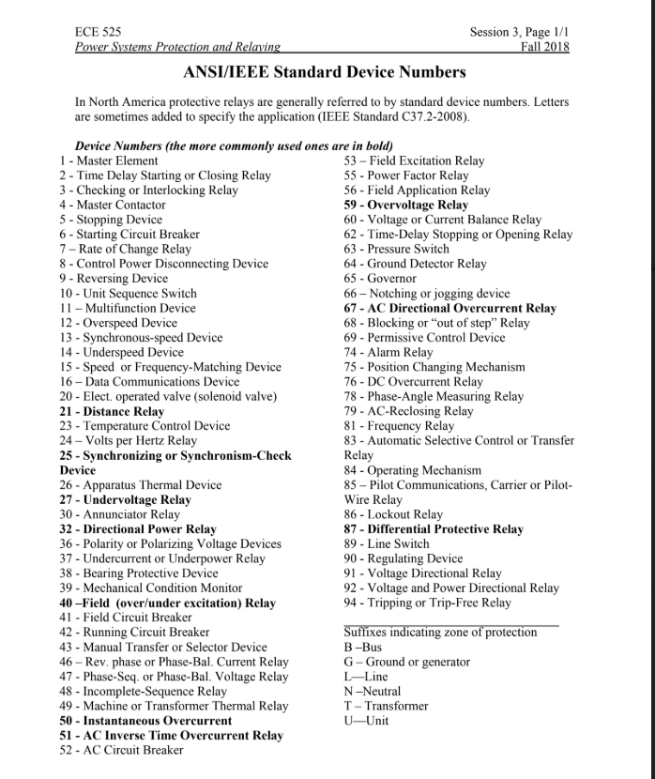
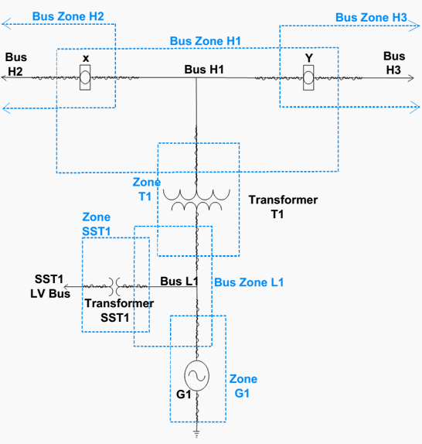

Slide 12
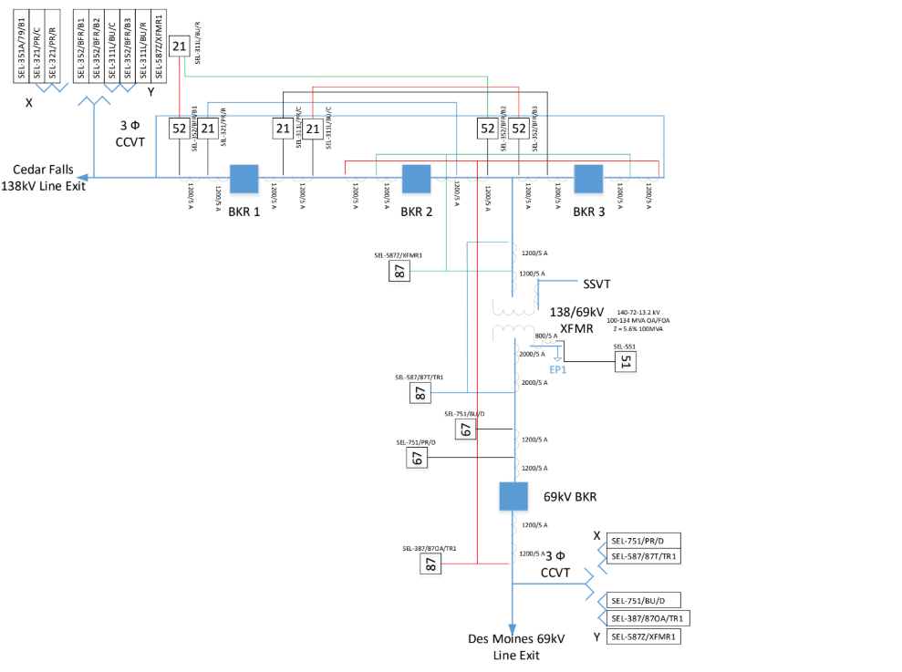
Drafting
Connect all the appropriate equipment according to the protection requirements document and the protection schemes
Converse with client on accuracy and standards that are being used

Slide 13
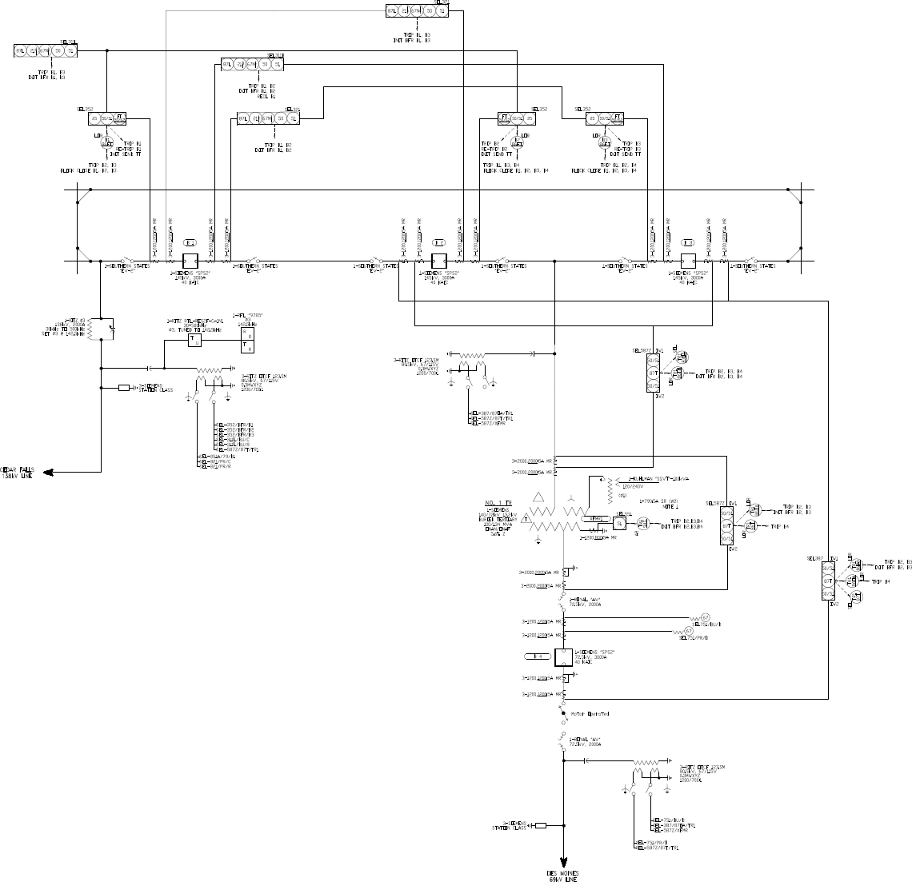
Completed
One-Line

Slide 14
Transformer Schematics

Slide 15
Methodology- Overview
DC transformer schematics
Determined necessary inputs and outputs on protection document
Verified protection document and one-line matched
Determined lockout relay output contact assignments
Drafting
QC check by other members of the group
Send to client to receive feedback
Modify and finalize

Slide 16
Completed
One-Line

Slide 17
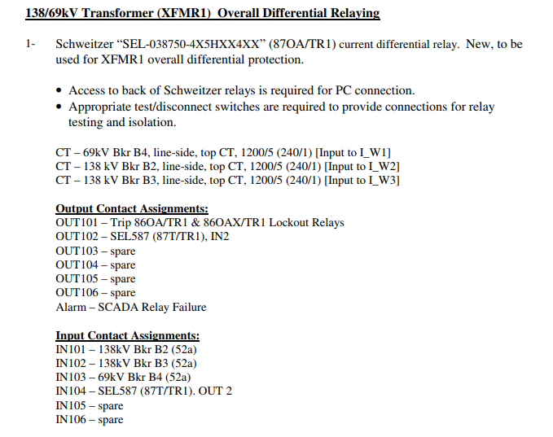
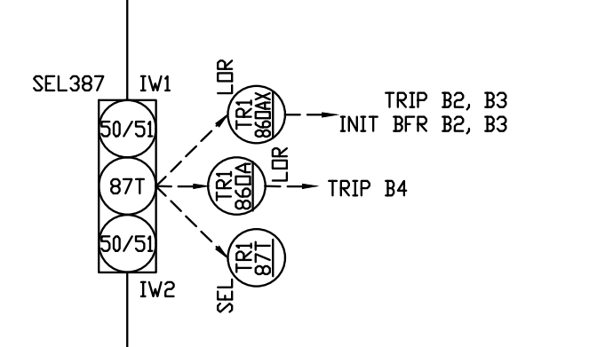
Inputs and Outputs on Protection Document

Slide 18
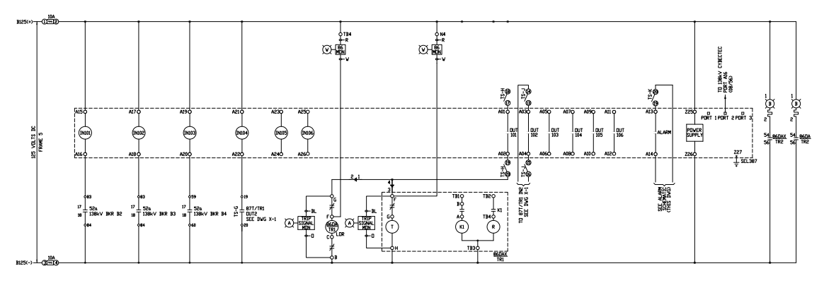
Drafting of DC Schematic

Slide 19
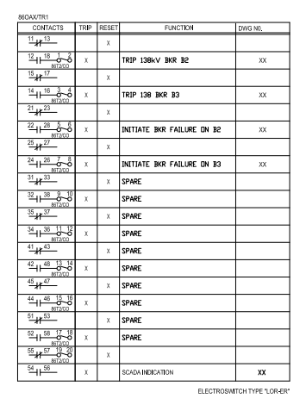
Lockout Relay

Slide 20
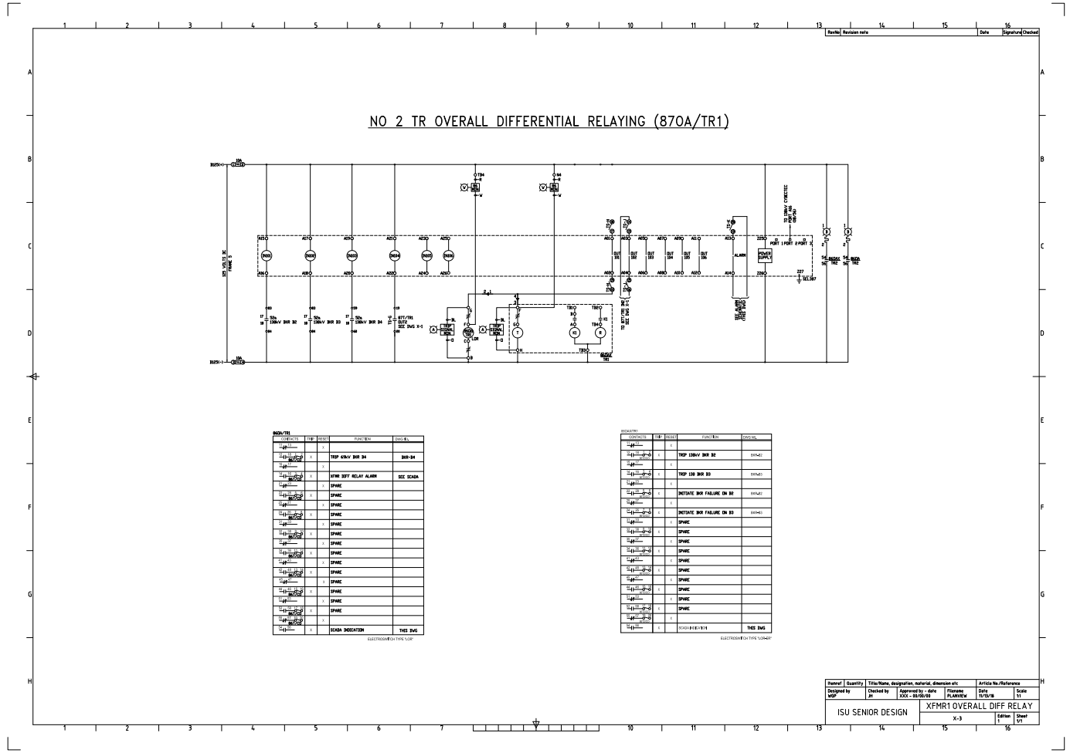
Completed Example (SEL 387)

Slide 21
Methodology- Overview
AC transformer schematics
Determine CTs from one-line
QC’d CTs with protection document
Drafting
QC check by other members of the group
Sent to client to receive feedback
Modify and finalize

Slide 22
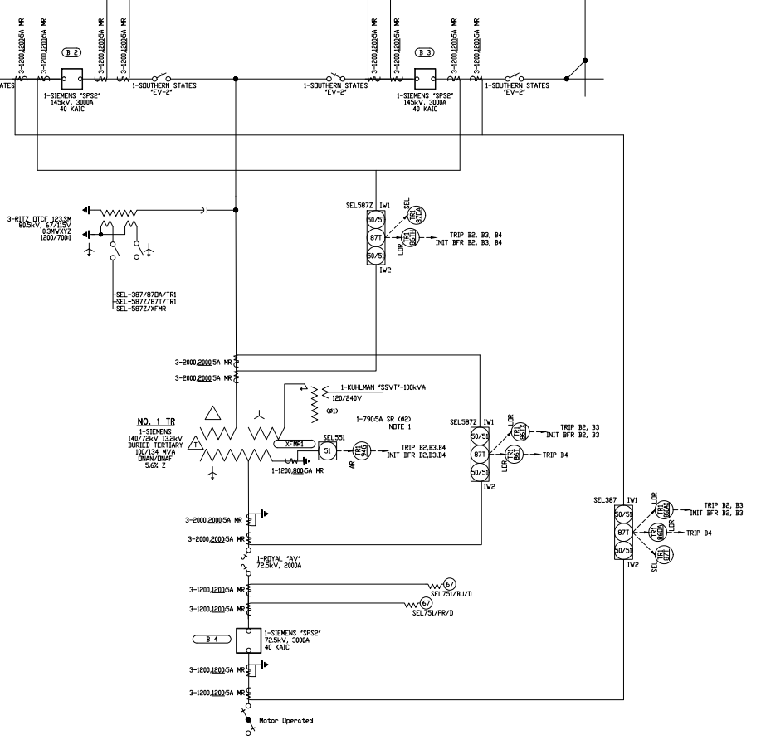
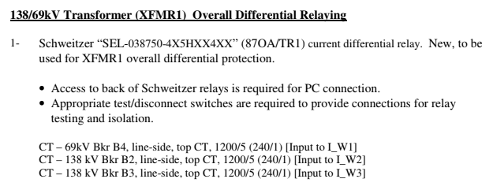
Completed Example (SEL-387)

Slide 23
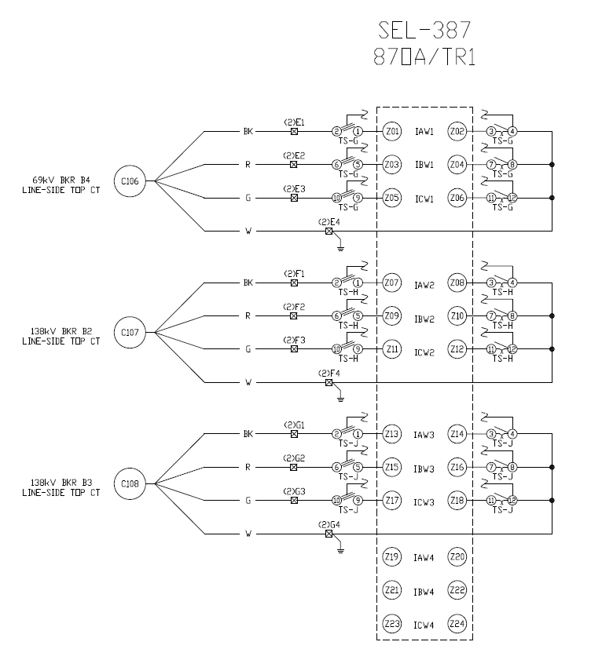
Completed Example (SEL-387)

Slide 24
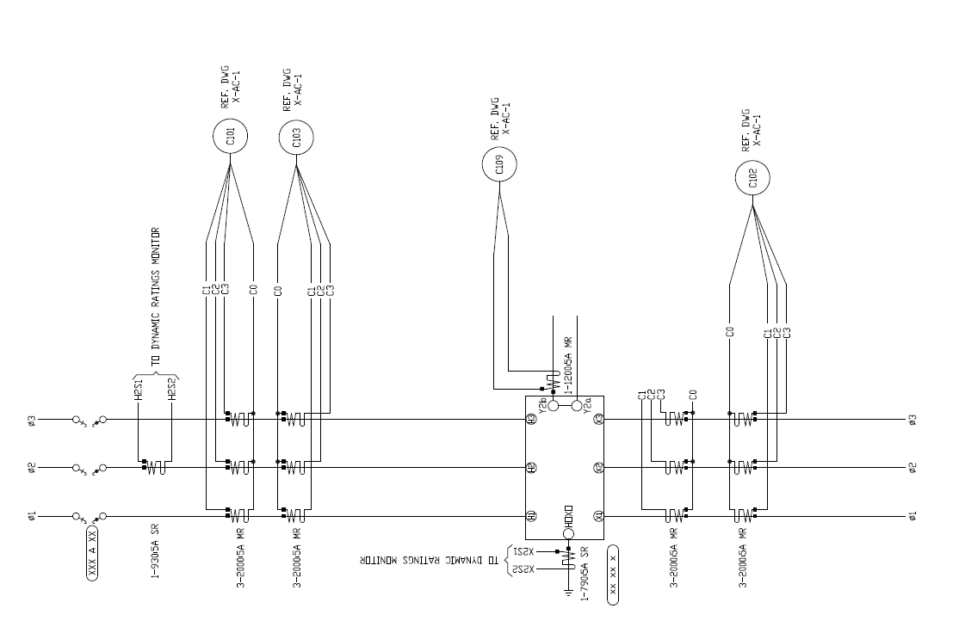
Completed AC Schematic

Slide 25
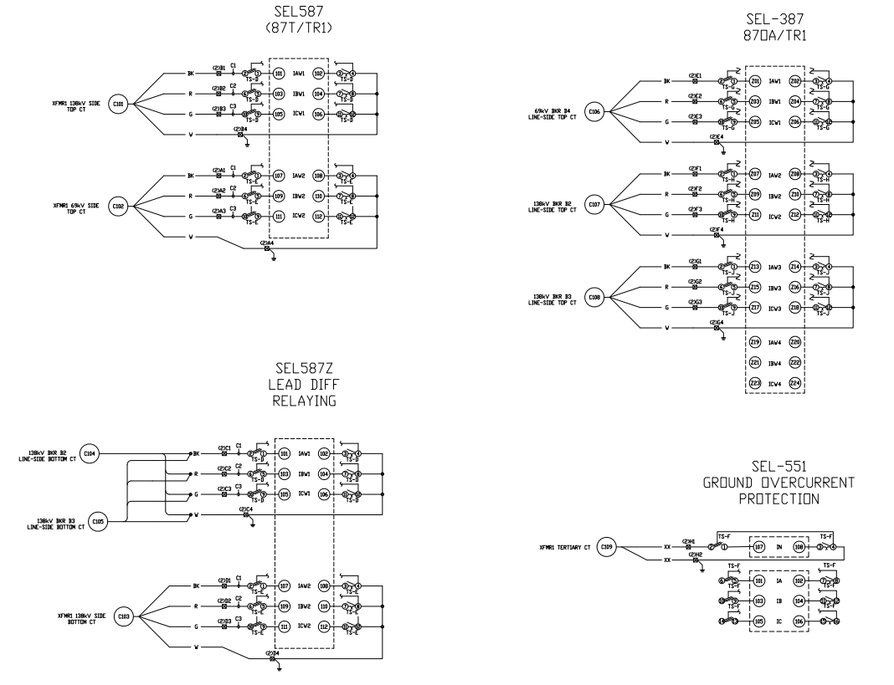

Slide 26
DC Study

Slide 27
Task and Data Provided by the Client
125V DC system.
Design to 1.75Vdc per cell. This equate to 105V on a 60 cell system.
Design based on an 8-hour duty cycle.
Design for a three phase, three wire 120/240 V system coming of the tertiary winding of the main substation transformer.
Choice of battery: Enesys CC-M Lead Acid Batteries

Slide 28
Methodology
Compile list of DC load elements and their respective amp draw levels
Create duty cycle diagram to determine battery set rating necessary
Determine worst case lockout scenario and amp draw
Calculate Battery Size
Calculate Battery Charger Size

Slide 29
Compile list of DC load elements and their respective amp draw levels

Slide 30
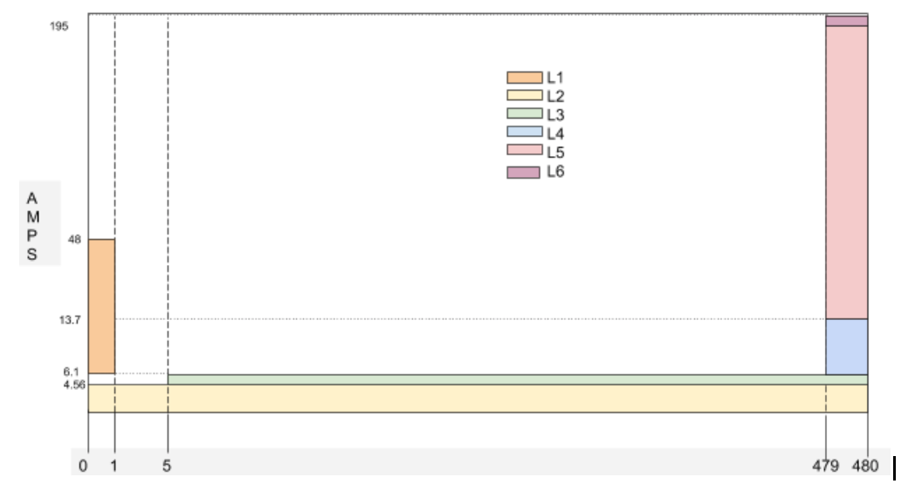
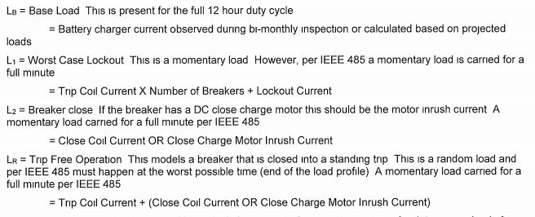
Create duty cycle diagram to determine battery set rating necessary

Slide 31
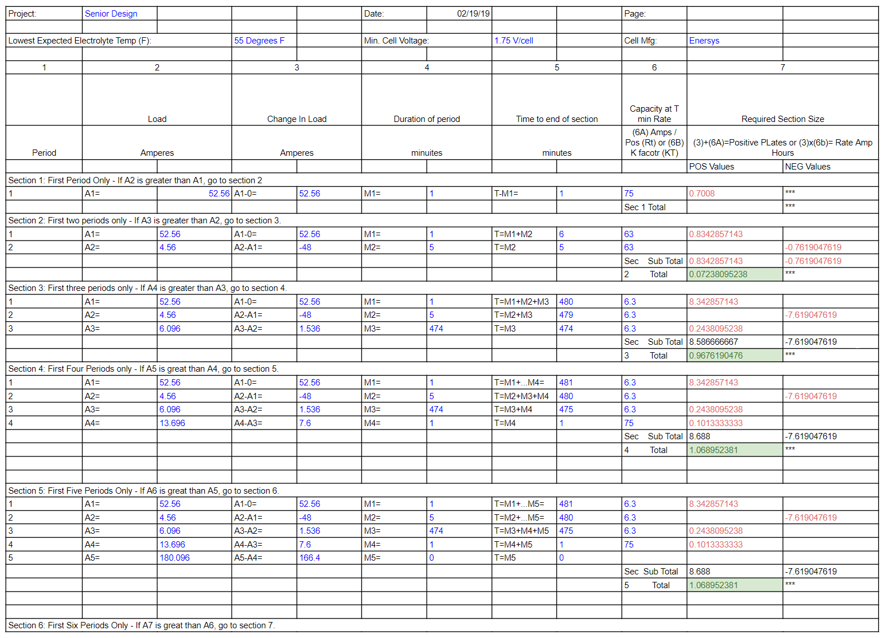
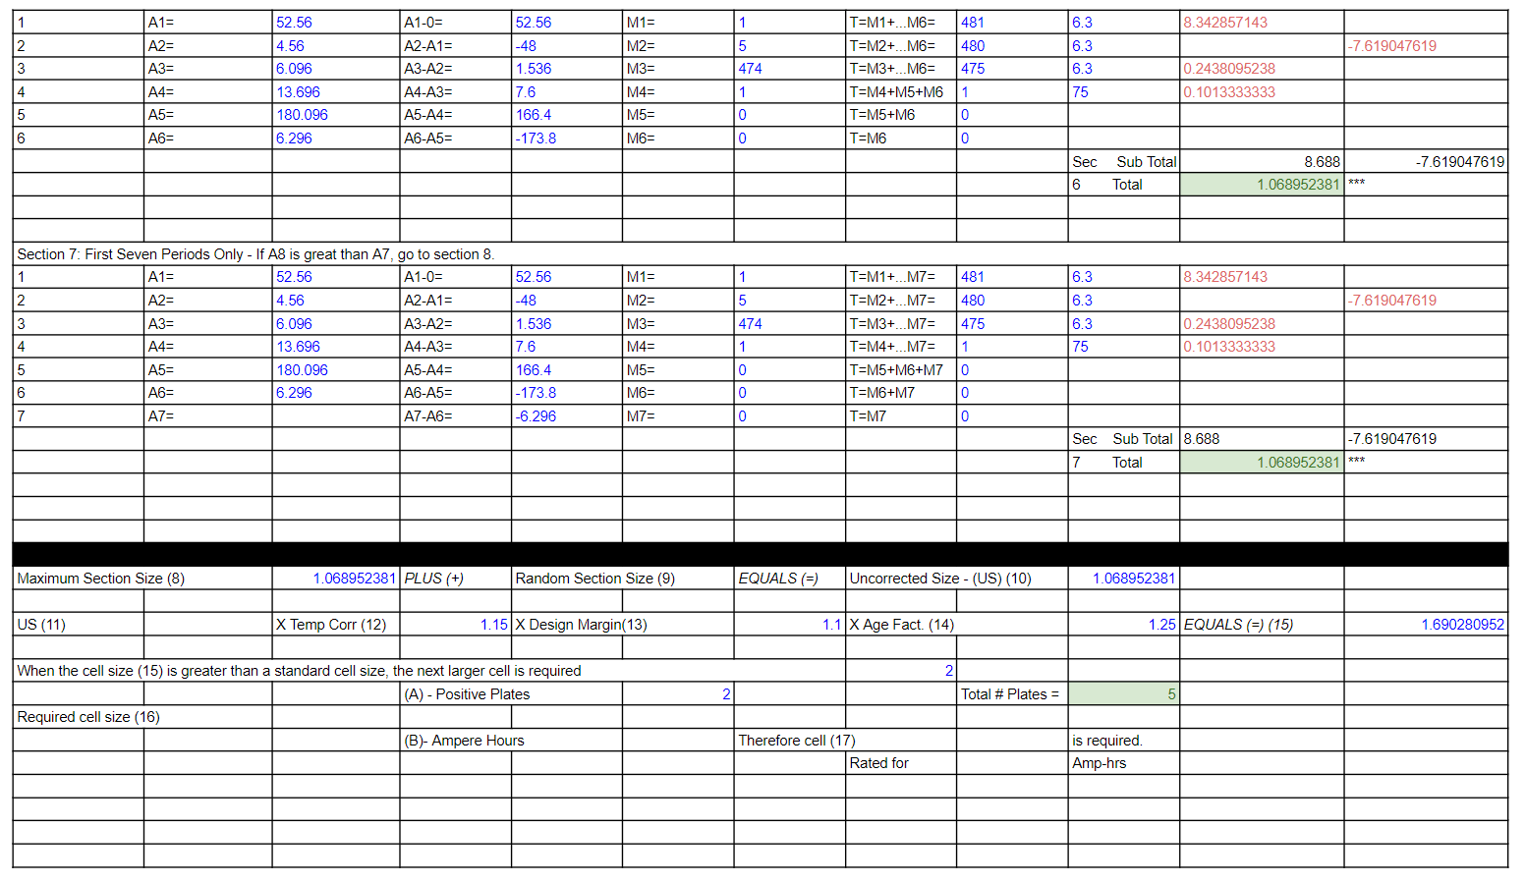

Slide 32
References
Burns & McDonnell Iowa State Senior Design Project 2018-2019 Protection Requirements Document. 24 Mar 2019
Burns & McDonnell One-Line Example Drawing. 24 Mar 2019
ANSI Code Table. 24 Mar 2019
Burns & McDonnell One-Line Example Sketch. 24 Mar 2019
IEEE Standard 3001.2-2017
Design Guide for Rural Substations, Section 12: Protective Relaying. 24 Mar 2019
IEEE 485-2010: IEEE Recommended Practice for Sizing Lead-Acid Batteries for Stationary Applications

